Slide 1
Leukemia Image Classification

Slide 2
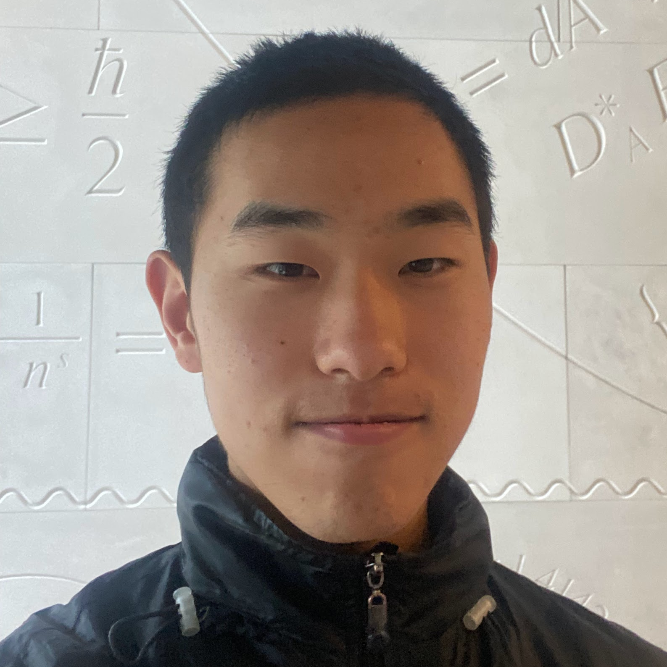
Company Name
Meet the team
William
Jerry
Year/Quarter/Month
Hi, I’m William, a senior majoring in Mathematics and minoring in Computer Science. I love math, and its applications in areas such as Machine Learning.
Hi, my name is Jerry, I’m a senior majoring in Computer Science and Applied Math.

Slide 3
Acute lymphoblastic leukemia is the most common cancer for children
Year/Quarter/Month
The Issue: Diagnosing ALL requires an expert to carefully analyze blood samples.
We used machine learning to analyze the blood samples for us.

Slide 4
Content
Goal
Step 1
Step 2
Step 3
Step 4
Year/Quarter/Month
Data Exploration
Linear Classifiers
Convolutional Neural Networks
CNN
ResNet
EfficientNet
Transformers
ViT
ConViT
Swin-T
Results/Future Steps

Slide 5
Data Exploration
Dataset: https://www.kaggle.com/datasets/andrewmvd/leukemia-classification [3]
Two classes: ALL(leukemia positive), and HEM(healthy cells)
10k samples loaded with multithreading
Loaded with OpenCV (skips corrupted images)
Imbalance of positive and negative classes: randomly sample an equal amount from bigger class
Split into train and test at 80-20 rates w sklearn
Load into custom Data Loader class
Converts to RGB and resizes to 224x224 (medical imaging convention)
Pixel Normalization
Data augmentation
Medical imaging data have low variance, randomly flip/rotate images to generate variated data

Slide 6
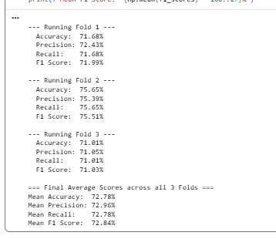
Linear Classifier
Images are 2d matrices of pixel values (int)
First idea - binary Logistic Regression classifier
Flatten image 224x224x3 -> 150528 features
3 - fold cross validation training
Results:
Average Accuracy: 72.78%
Average Precision: 92.96%
Mean Recall: 72.78%
Mean F1 Score: 72.84%
Issues
Only position of pixels and what color they are matter and doesn’t generalize, no feature recognition in images.

Slide 7
CNN
Convolutions - small filters slide across images and can detect features like edges, lines, textures
Nearby pixels processed together providing more information
Model Architecture
3 Convolutional Blocks
Convolution -> Batch Normalization->ReLu activation -> Max Pooling
Fully Connected linear classifier with 0.5 Dropout.
Trained with:’
Adam optimizer (Learning rate 1e-4, Cross Entropy Loss)
Results: 86% accuracy
Limitations
Shallow architecture + trained from scratch (requires much more data + deeper levels for meaningful data extraction)

Slide 8
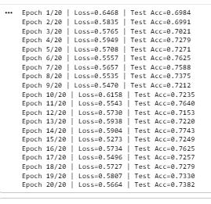
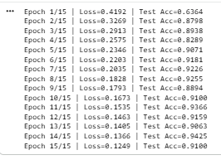
Fine Tuning
ResNet
Residual connections in layers - solves vanishing gradients and deeper layers
Loaded Resnet18 pretrained on ImageNet replaced with a binary classifier, then trained on our data.
Accuracy: 76% (not sure why this sucked)
EfficientNet
Compound scaling in images (balances depth,width/resolution)
EfficientNet-B0 loaded and trained and augmented in same way
Accuracy: ~91-94%

Slide 9
Visual Transformers
Self-Attention - Allows every patch of the image to interact with every other patch - provides global context rather than just local context within filters.
Architecture -
Transformer Encoder layers
Multi-head attention
Feed forward Multi-Layer Perceptron
16x16 patch size trained for 25 epochs w Cross entropy loss and LR 0.01
Results:
Transformers normally require a lot more data to perform well
After class equalization we have ~6000 samples with 80-20 train test splits
84% | weighted F1 score
82% | sensitivity
67% | specificity

Slide 10
ConViT
We use Convolutional Visual Transformers from “ConViT: Improving Vision Transformers with Soft Convolutional Inductive Biases.” [1]
Has soft convolutional bias of CNNs to get local properties
Uses ViT’s self-attention to get the global picture.
Able to perform with less training data.
92% | weighted F1 score
92% | sensitivity
83% | specificity

Slide 11
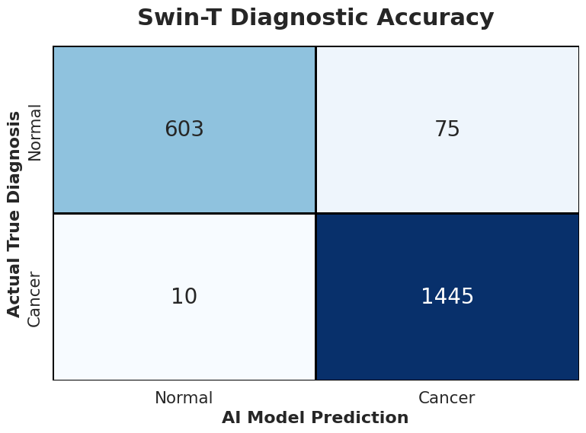
Swin-T
The best method uses Shifted Windows Transformers from “Swin Transformer: Hierarchical Vision Transformer using Shifted Windows” [2].
Metrics
Confusion Matrix
Clinical Takeaways
97% | weighted F1 score
99% | sensitivity
98% | specificity
Local feature attention Swin-T’s shifted windows allow for close examination of nucleus
Fast Executes in seconds, making it viable to use in rural clinics

Slide 12
Bibliography
D’Ascoli, S., Touvron, H., Leavitt, M.L., Morcos, A.S., Biroli, G. &amp; Sagun, L.. (2021). ConViT: Improving Vision Transformers with Soft Convolutional Inductive Biases., in Proceedings of Machine Learning Research 139:2286-2296 Available from https://proceedings.mlr.press/v139/d-ascoli21a.html.
Liu, Z., Lin, Yutong, L., Cao, Y., Hu, H., Wei, Y., Zhang, Z., Lin, S., Guo, B. (2021), Swin Transformer: Hierarchical Vision Transformer using Shifted Windows., in arXiv:2103.14030
Gupta, A., & Gupta, R. (2019). ALL Challenge dataset of ISBI 2019 [Data set]. The Cancer Imaging Archive. https://doi.org/10.7937/tcia.2019.dc64i46r

Slide 13
Thank you

